Slide 1
Task-4: Hiring Process Analytics

Slide 2
Excel Tasks:
Data Handling Tasks:
Handling Missing Data
Clubbing Columns
Outliner Detection
Removing Outliners
Data Summary
Data Analytics Tasks:
Hiring Analysis
Salary Analysis
Salary Distribution
Departmental Analysis
Position Tier Analysis
Software Used: Microsoft Excel

Slide 3
My Approach:
DATA HANDLING
My First goal is to clearly understand the given data and Columns.
Then, Checking for any Missing values, identifying Outliners and removing them.
Analyzing the given data with the help of Pivot Tables, Bar graphs, and Pie Charts.
Finally, Solving the given tasks with the help Excel and Obtain the useful Insights from the data.

Slide 4
1) Hiring Analysis:
DATA ANALYSIS
The hiring process involves bringing new individuals into the organization for
various roles.
Task: Determine the gender distribution of hires. How many males and females
have been hired by the company?
Function:
=COUNTIFS(D:D,"Male",C:C,"Hired")
=COUNTIFS(D:D,“Female",C:C,"Hired")
=SUM(Q12,Q13)
Output:
Males Hired = 2563
Females Hired= 1856
Total Hired = 4419

Slide 5
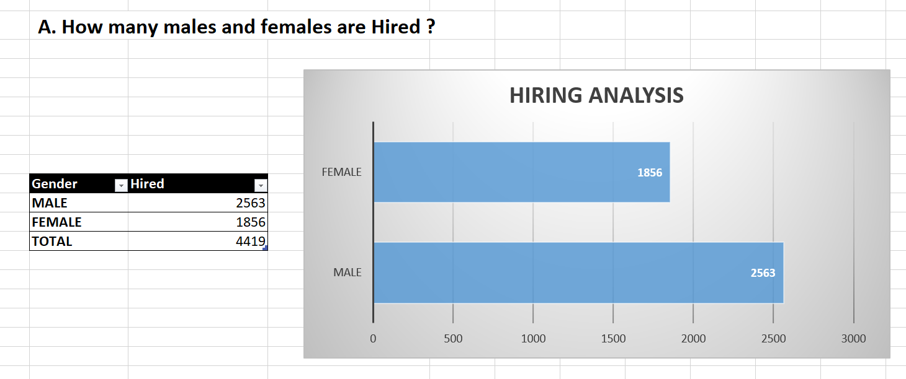
1) Hiring Analysis:
DATA ANALYSIS
The hiring process involves bringing new individuals into the organization for
various roles.
Task: Determine the gender distribution of hires. How many males and females
have been hired by the company?
Result:

Slide 6
2) Salary Analysis:
DATA ANALYSIS
The average salary is calculated by adding up the salaries of a group of employees
and then dividing the total by the number of employees.
Task: What is the average salary offered by this company? Use Excel functions to
calculate this.
Function:
We can find Average in Two methods one using direct formula, and the other one is by creating a Pivot table and finding out the Average Salaries offered by each department.
Here, I have used the second method.
Output:
The Average Salary Offered by the company is 49983.029

Slide 7
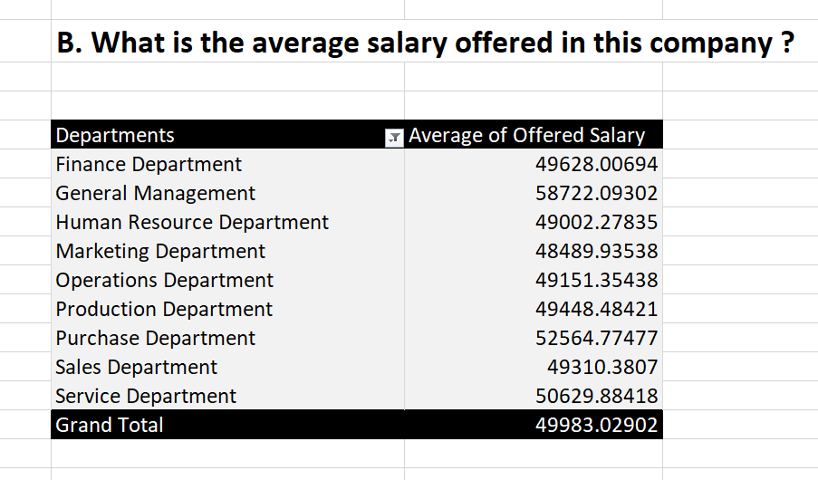
2) Salary Analysis:
DATA ANALYSIS
The average salary is calculated by adding up the salaries of a group of employees
and then dividing the total by the number of employees.
Task: What is the average salary offered by this company? Use Excel functions to
calculate this.
Result:

Slide 8
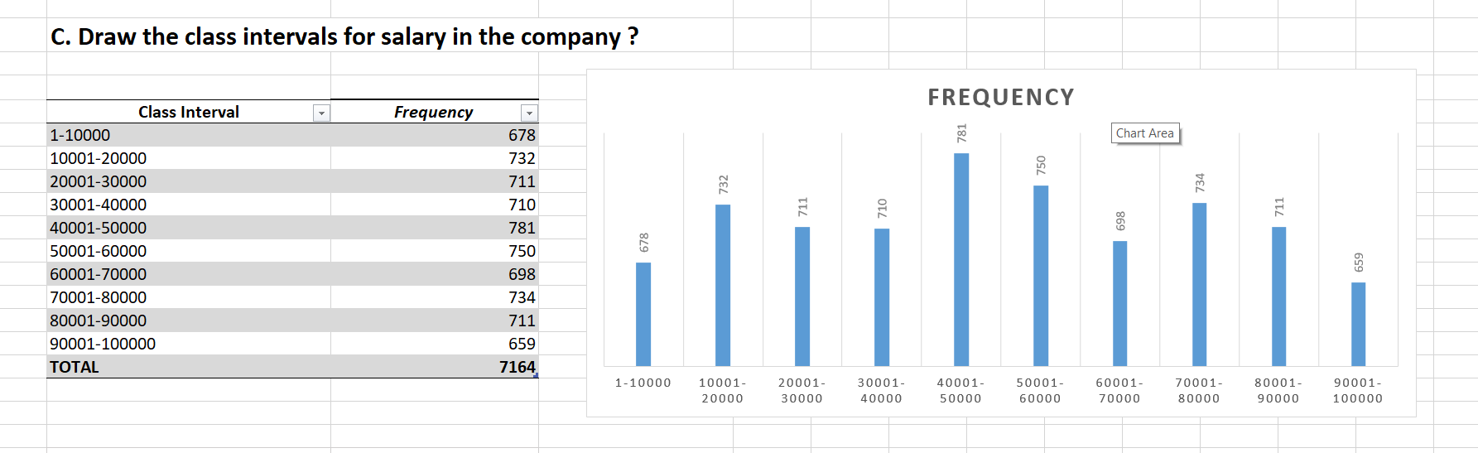
3) Salary Distribution:
DATA ANALYSIS
Class intervals represent ranges of values, in this case, salary ranges. The class
interval is the difference between the upper and lower limits of a class.
Task: Create class intervals for the salaries in the company. This will help you
understand the salary distribution.
Result:

Slide 9
3) Salary Distribution:
DATA ANALYSIS
Class intervals represent ranges of values, in this case, salary ranges. The class
interval is the difference between the upper and lower limits of a class.
Task: Create class intervals for the salaries in the company. This will help you
understand the salary distribution.
Visualization:

Slide 10
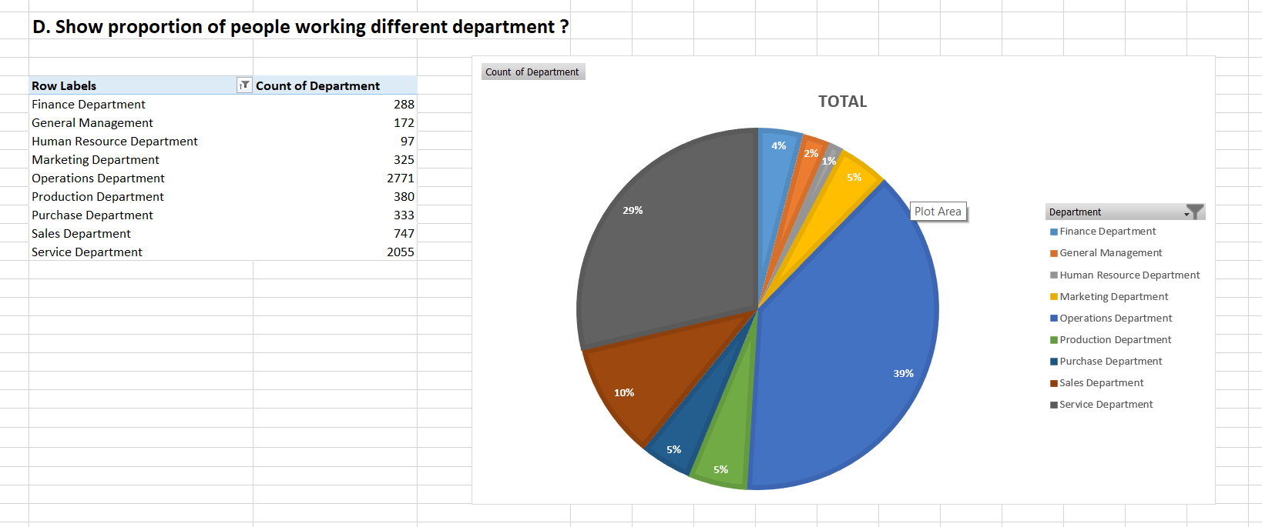
4) Departmental Analysis:
DATA ANALYSIS
Visualizing data through charts and plots is a crucial part of data analysis.
Task: Use a pie chart, bar graph, or any other suitable visualization to show the
proportion of people working in different departments.
Result:

Slide 11
4) Departmental Analysis:
DATA ANALYSIS
Visualizing data through charts and plots is a crucial part of data analysis.
Task: Use a pie chart, bar graph, or any other suitable visualization to show the
proportion of people working in different departments.
Visualization:

Slide 12
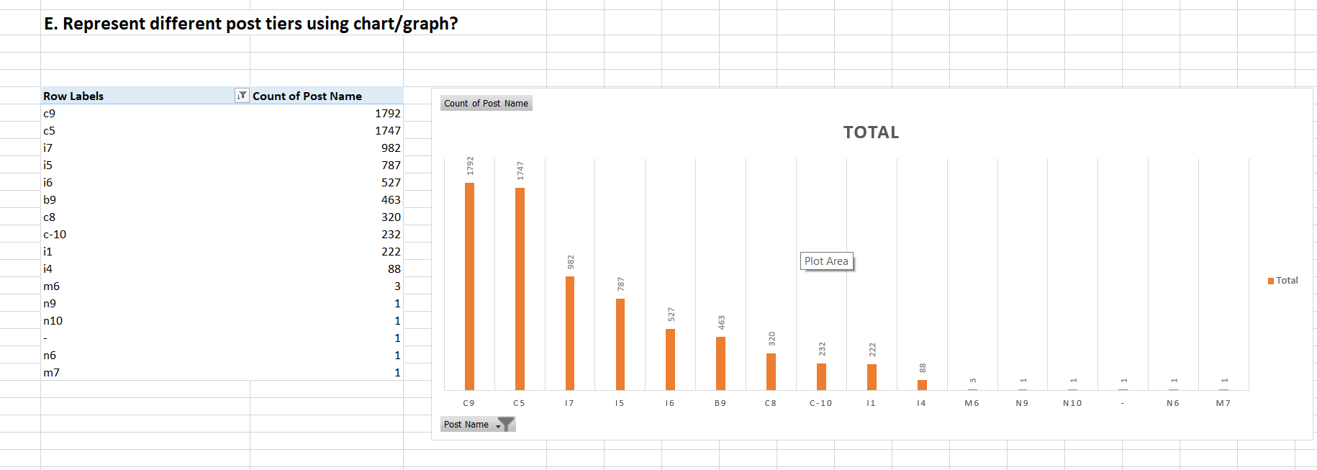
5) Position Tier Analysis:
DATA ANALYSIS
Different positions within a company often have different tiers or levels.
Task: Use a chart or graph to represent the different position tiers within the
company. This will help you understand the distribution of positions across
different tiers.
Result:

Slide 13
5) Position Tier Analysis:
DATA ANALYSIS
Visualization:

Slide 14
Conclusion
All the tasks which are given as Hiring Process Analytics has been solved with appropriate results.
For completing these tasks, I have used Microsoft Excel and Power point.
The Results are also Visualized using Bar graphs and Pie Charts.
The Task results Excel sheet Link is also provided along with the report.
https://docs.google.com/spreadsheets/d/1yvREQiV7RRVReSMDvF3GDYiCRZstdIdO/edit?usp=drive_link&ouid=113249253121491889461&rtpof=true&sd=true
Thank You

